Slide 1

Subscription based chat application (Subscription Module) Organization: Grameen Communications Designation: Software Developer Intern Joining Date: 13/03/2022
Members: Rafid Al Ahsan (1722006),
Tiasha swarnaker (1820874),
Maksura akter ety (1820999)
Spring 2022

Slide 2
Introduction
On March 13, 2020 based on an academic-industrial collaboration between Independent University, Bangladesh and Grameen Communication we started our internship journey.
The presentation is divided into three segments
1) What we have learned so far
2) Subscription based chat application (Subscription Module)
3) Final Outcome

Slide 3
After joining what we have learned so far
Created an Excel sheet containing brief description and syntax of all software technologies
Creating user interface of chat application using HTML5,CSS3 and BootStrap5
Business Requirement Document for chat application
Created and CRUD application using Laravel and Vue.js 3
BRD - https://docs.google.com/document/d/1I-qM2Pi51Vsr-bV5PmlkeqfN-yA8tT2XKJaDxS0U7u4/edit?fbclid=IwAR0pmh7OBDyl1RzGluh2-UdISrGgsyFd8aE0WGTj4wwrWh35RuqmymwXAfM

Slide 4
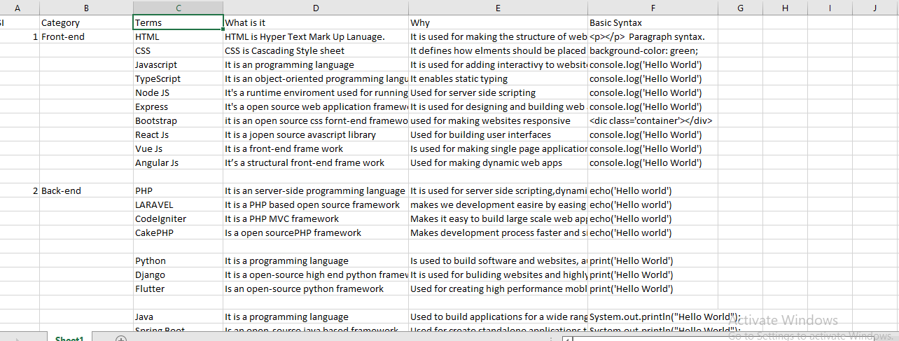
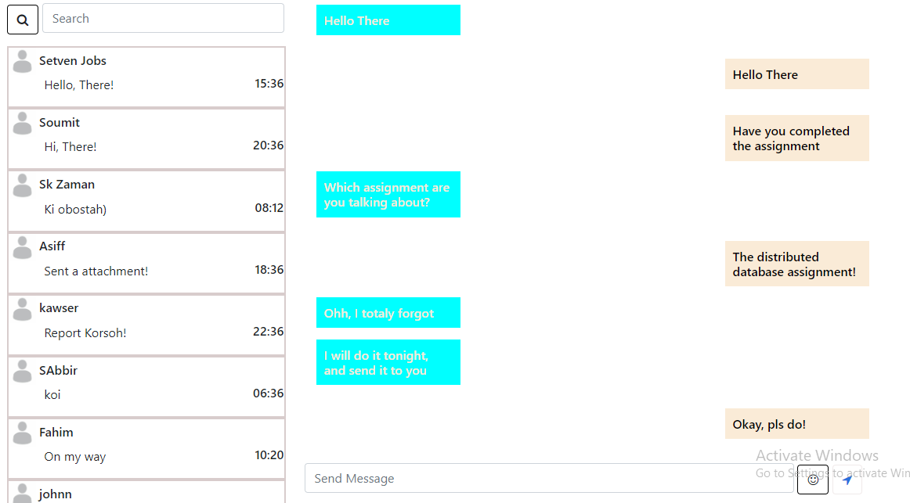
Excel Sheet
Chat App UI

Slide 5
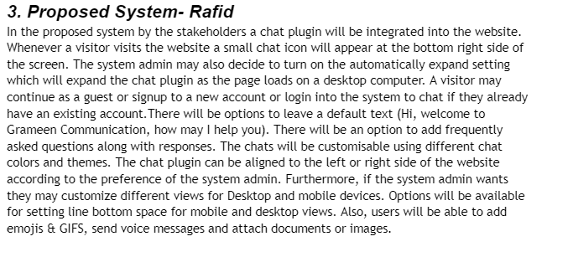
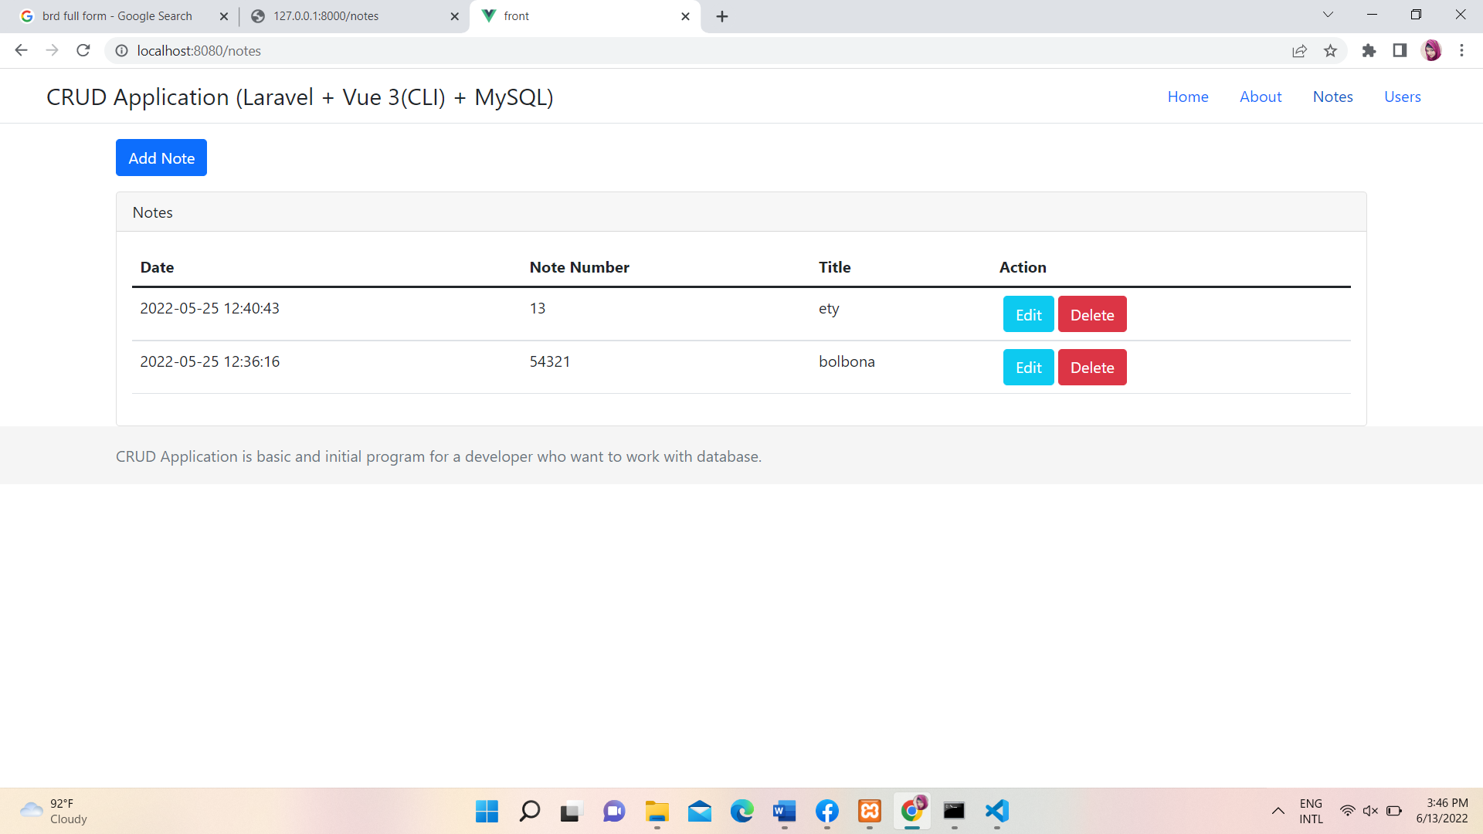
Business Requirement Document
Vue & Laravel CRUD Operation

Slide 6
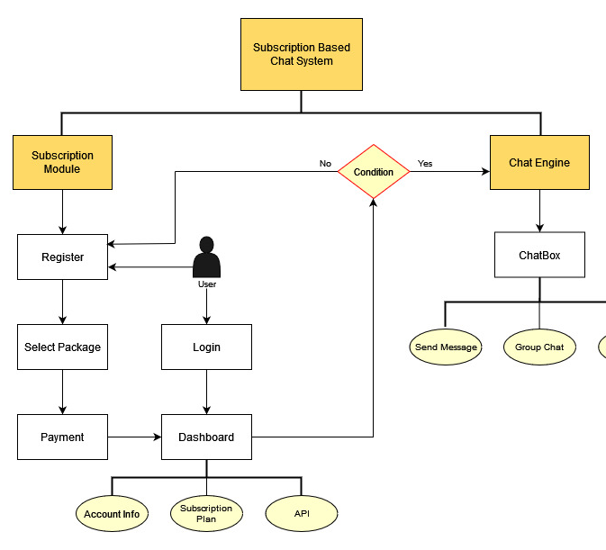
Subscription based chat application (Subscription Module)
Secure login and signup
Easy to and beautiful looking user interface
Subscription plan
Payment Gateway
Dashboard design

Slide 7
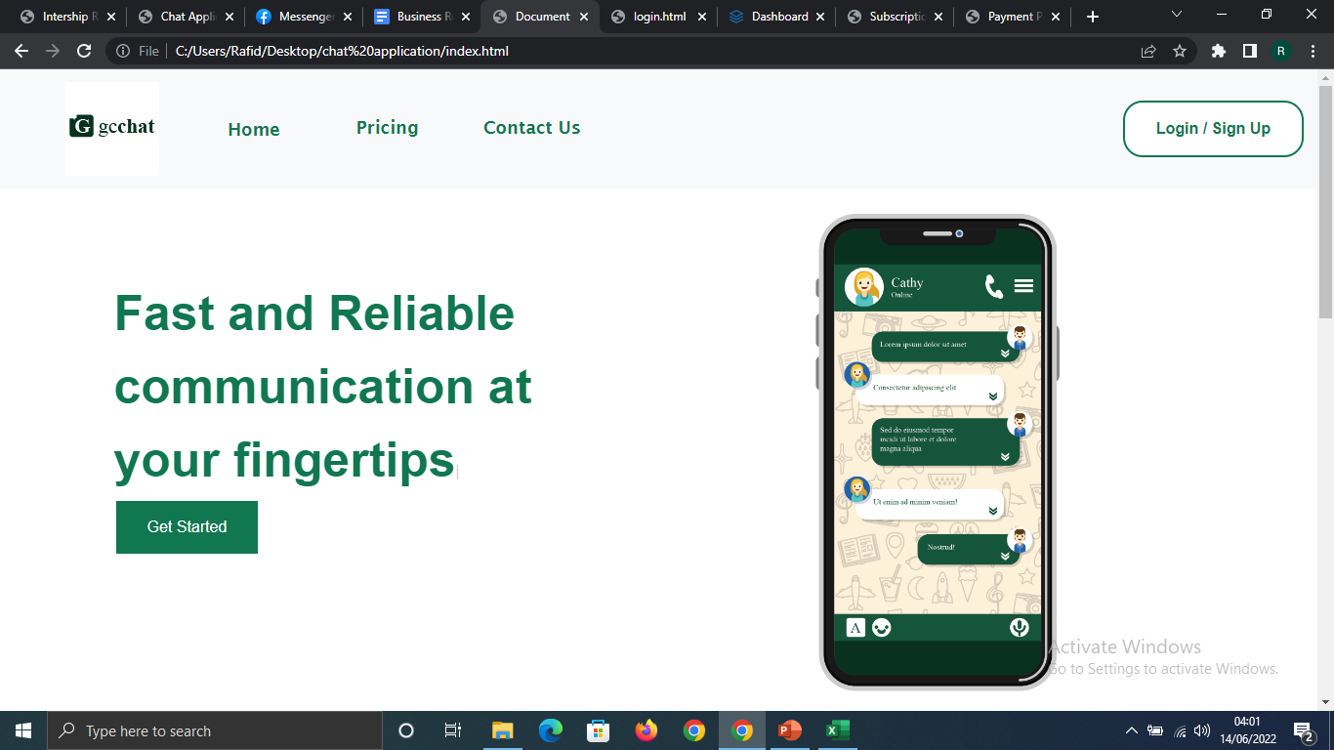
Landing Page

Slide 8
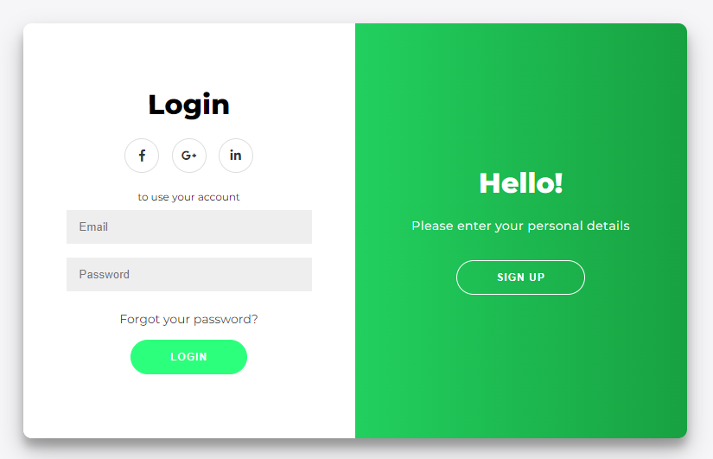
Login & Sign up page

Slide 9
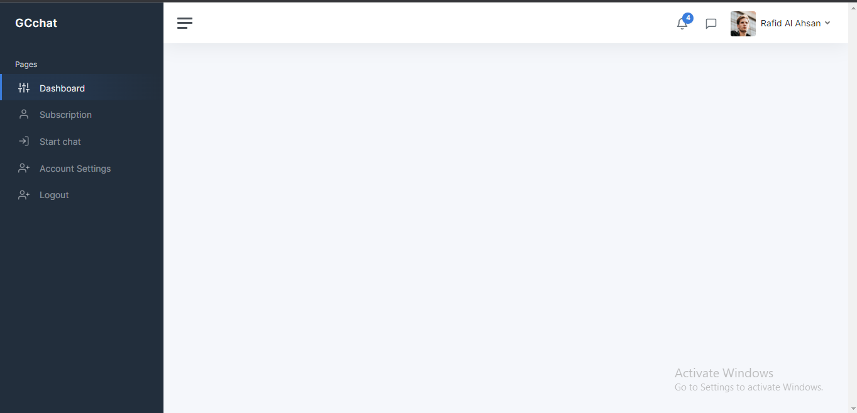
Dashboard

Slide 10

Subscription Page

Slide 11
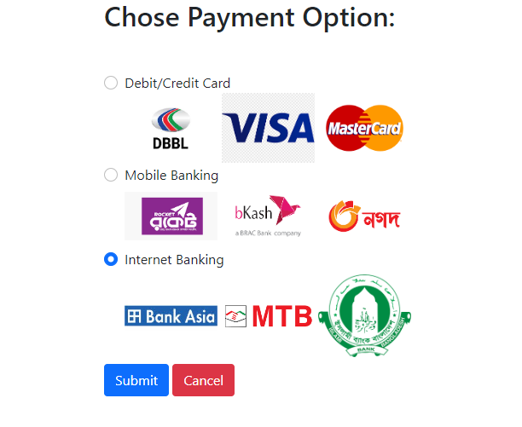
Payment Page

Slide 12
Final Outcome
After this chat application is fully developed users will be able to chat with one another.
The speciality of this chat application is that it is light-weight and has a beautiful looking, easy to use Graphical User Interface
The chat application is also very secure has it has login and signup verification
Initially it will be used for internal purposed of Grameen Communication and later, be released as a commercial software.
After successful completion of this internship, we have got used to the office culture.
This experience that we have gathered during the internship will help us further in our future careers for finding jobs and working in corporate places.

Slide 13
Thank
you

